Slide 1



Introduction to HTML and WordPress
HTML and WordPress are two powerful tools that have revolutionized the way we create and maintain websites. In this presentation, we'll explore the fundamentals of each, their unique advantages, and when to choose one over the other.
by Mohammad Javad Sharifi

Slide 2

What is HTML?
1
Markup Language
HTML (Hypertext Markup Language) is the standard markup language used to create and structure web pages.
2
Static Content
HTML is primarily used to define the content, layout, and structure of a webpage, without any dynamic functionality.
3
Open-Source
HTML is an open-source language, allowing developers to freely create and customize websites.

Slide 3
Fundamentals of HTML
Elements
Structure
Markup
HTML uses a system of tags, attributes, and elements to define the structure and content of a web page.
The basic structure of an HTML document includes the DOCTYPE, HTML, HEAD, and BODY tags.
HTML markup is used to create headings, paragraphs, links, images, and other elements on a web page.

Slide 4
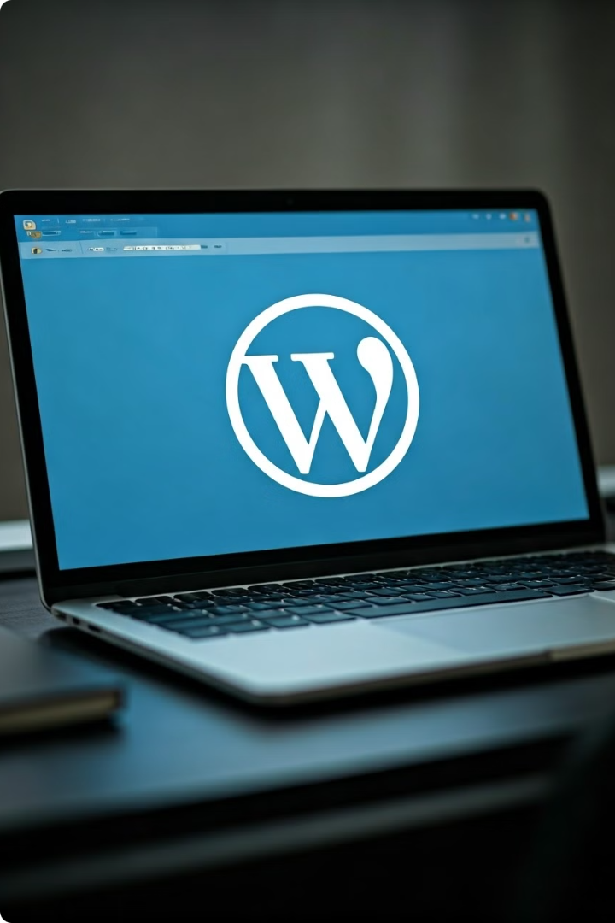
What is WordPress?
Content Management System
WordPress is a popular open-source Content Management System (CMS) used to build and manage websites.
Flexible Platform
WordPress offers a wide range of themes, plugins, and customization options to create diverse, feature-rich websites.
User-Friendly
WordPress is known for its intuitive interface, making it accessible for both developers and non-technical users.
Community-Driven
WordPress benefits from a large and active community of developers, designers, and users who contribute to its growth and improvement.

Slide 5
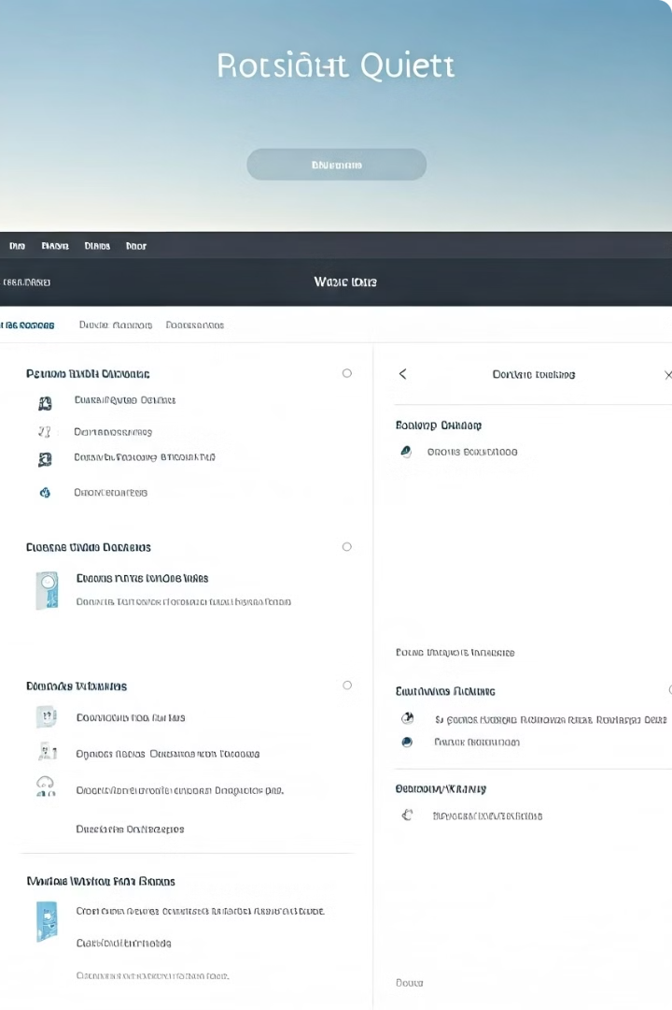
WordPress as a Content Management System
1
Content Creation
WordPress allows users to easily create and manage different types of content, including blog posts, pages, and media.
2
Website Management
WordPress provides a user-friendly interface for managing website settings, themes, plugins, and user roles.
3
Scalability
WordPress can scale to accommodate websites of all sizes, from personal blogs to large-scale enterprise solutions.

Slide 6
Differences between HTML and WordPress
Static vs Dynamic
Coding vs GUI
Customization
HTML creates static, content-driven websites, while WordPress is a dynamic CMS that allows for user interactions and content management.
HTML requires manual coding, while WordPress offers a user-friendly graphical interface for website creation and management.
HTML provides more flexibility for custom designs, while WordPress offers a wide range of pre-built themes and plugins.

Slide 7

Advantages of HTML
1
Simplicity
2
Control
HTML is a straightforward and easy-to-learn language, making it accessible for beginners.
HTML allows developers to have complete control over the structure and design of a website.
3
Performance
4
Security
HTML-based websites can often load faster and perform better than CMS-driven sites.
HTML-based websites are generally less vulnerable to security threats compared to CMS-driven sites.

Slide 8
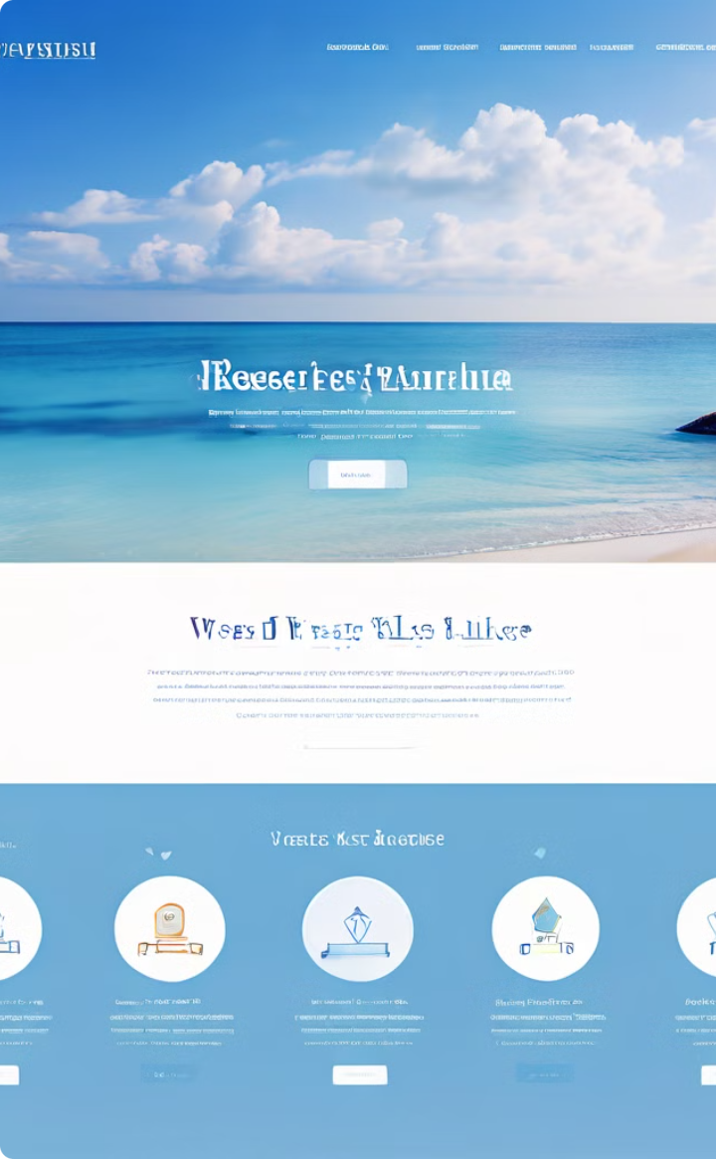




Advantages of WordPress
Content Management
WordPress simplifies the process of creating, publishing, and managing website content.
Extensibility
WordPress offers a vast ecosystem of plugins that can add new features and functionalities.
User-Friendliness
WordPress is known for its intuitive and user-friendly interface, making it accessible to non-technical users.
Community Support
The WordPress community provides a wealth of resources, tutorials, and support for users and developers.

Slide 9



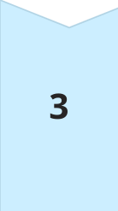
When to use HTML vs WordPress
Simple Websites
HTML is a great choice for creating simple, static websites with a focus on content and design.
Content Management
WordPress excels at creating dynamic, content-driven websites with features like blogging, e-commerce, and user interactivity.
Customization
HTML provides more flexibility for custom designs and unique functionality, while WordPress offers a wealth of pre-built themes and plugins.

Slide 10

Conclusion and Key Takeaways
1
HTML and WordPress
HTML and WordPress both have their strengths and are suitable for different website development needs.
2
Choosing the Right Tool
Consider your project's requirements, desired level of customization, and the target audience when deciding between HTML and WordPress.
3
Continuous Learning
Stay updated with the latest trends and best practices in web development to make informed decisions and create successful websites.

